Slide 1

NFL Quarterback Analytics
Kyle Kraichely, Preston Howard

Slide 2
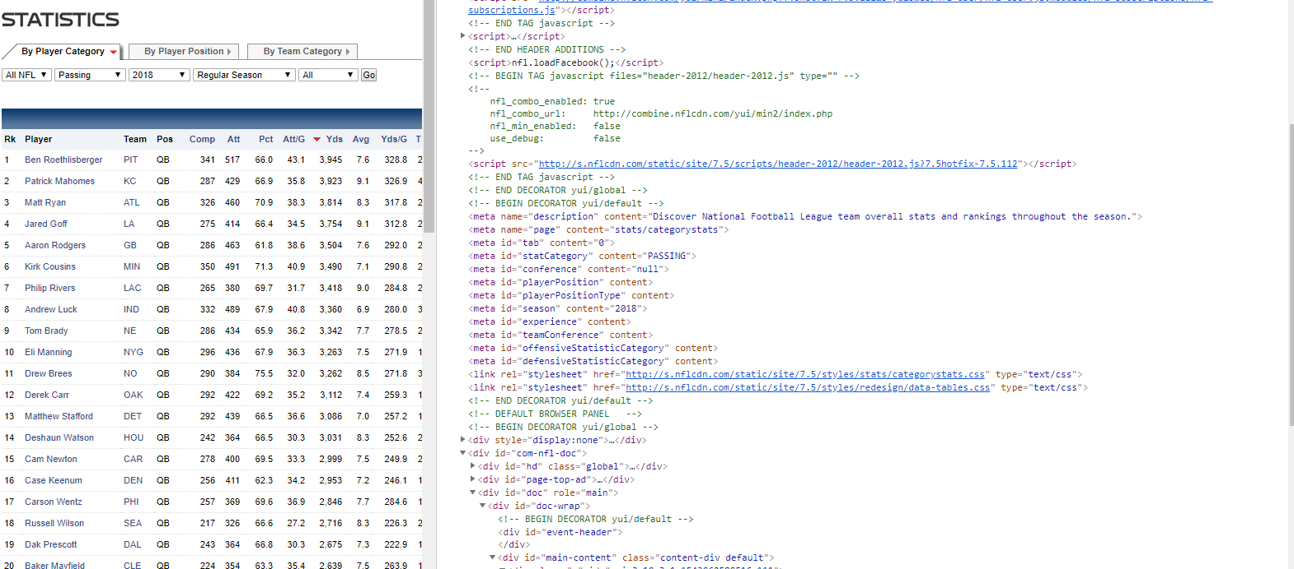
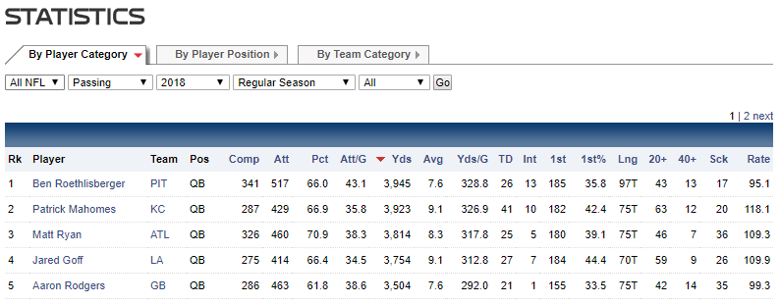
A web scraper was built to extract statistics from NFL.com

Slide 3
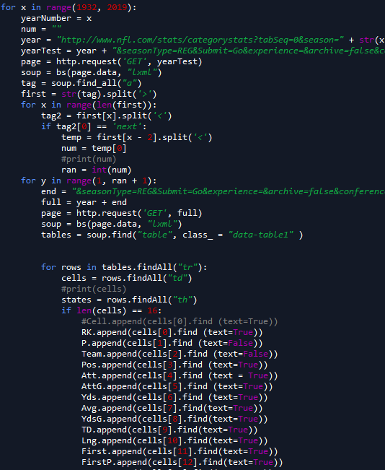
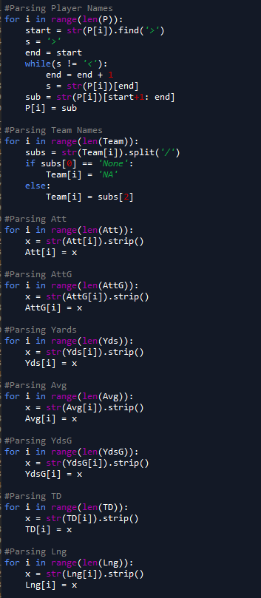
Logic was developed to effectively parse all available data from NFL.com

Slide 4
Parsed data was cleaned using data wrangling techniques
String Replace to remove commas and dashes
Convert all numeric fields to floating point or integers
Dropped all non QB data points
Spliced data to focus to clean up outliers

Slide 5
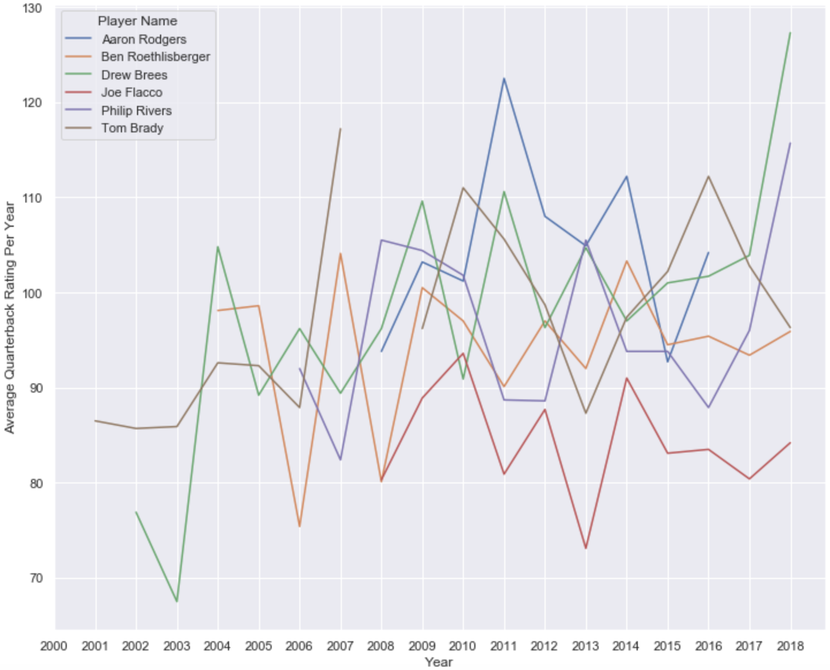
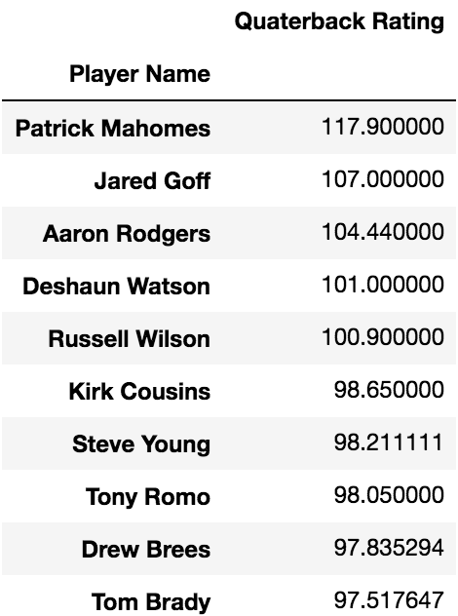
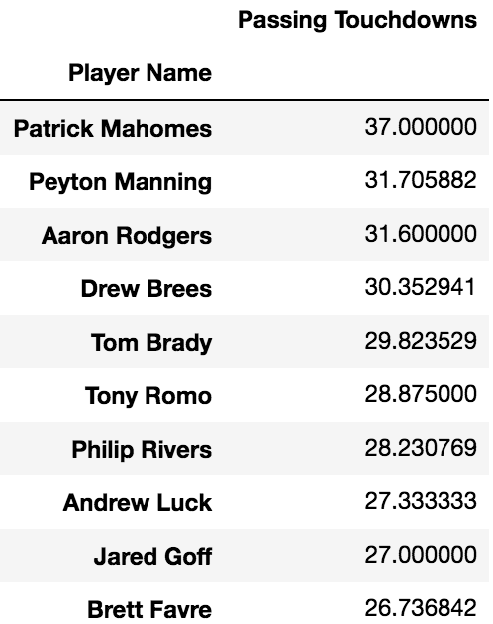
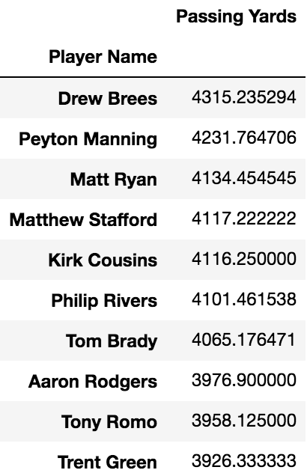
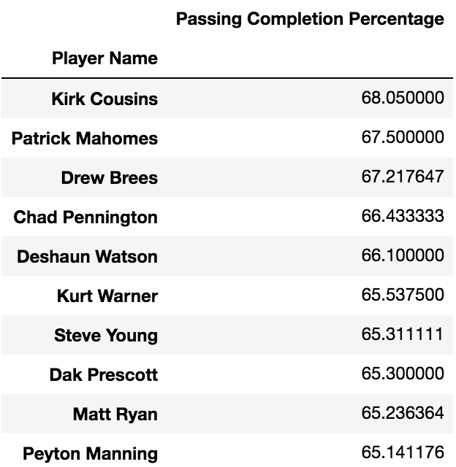
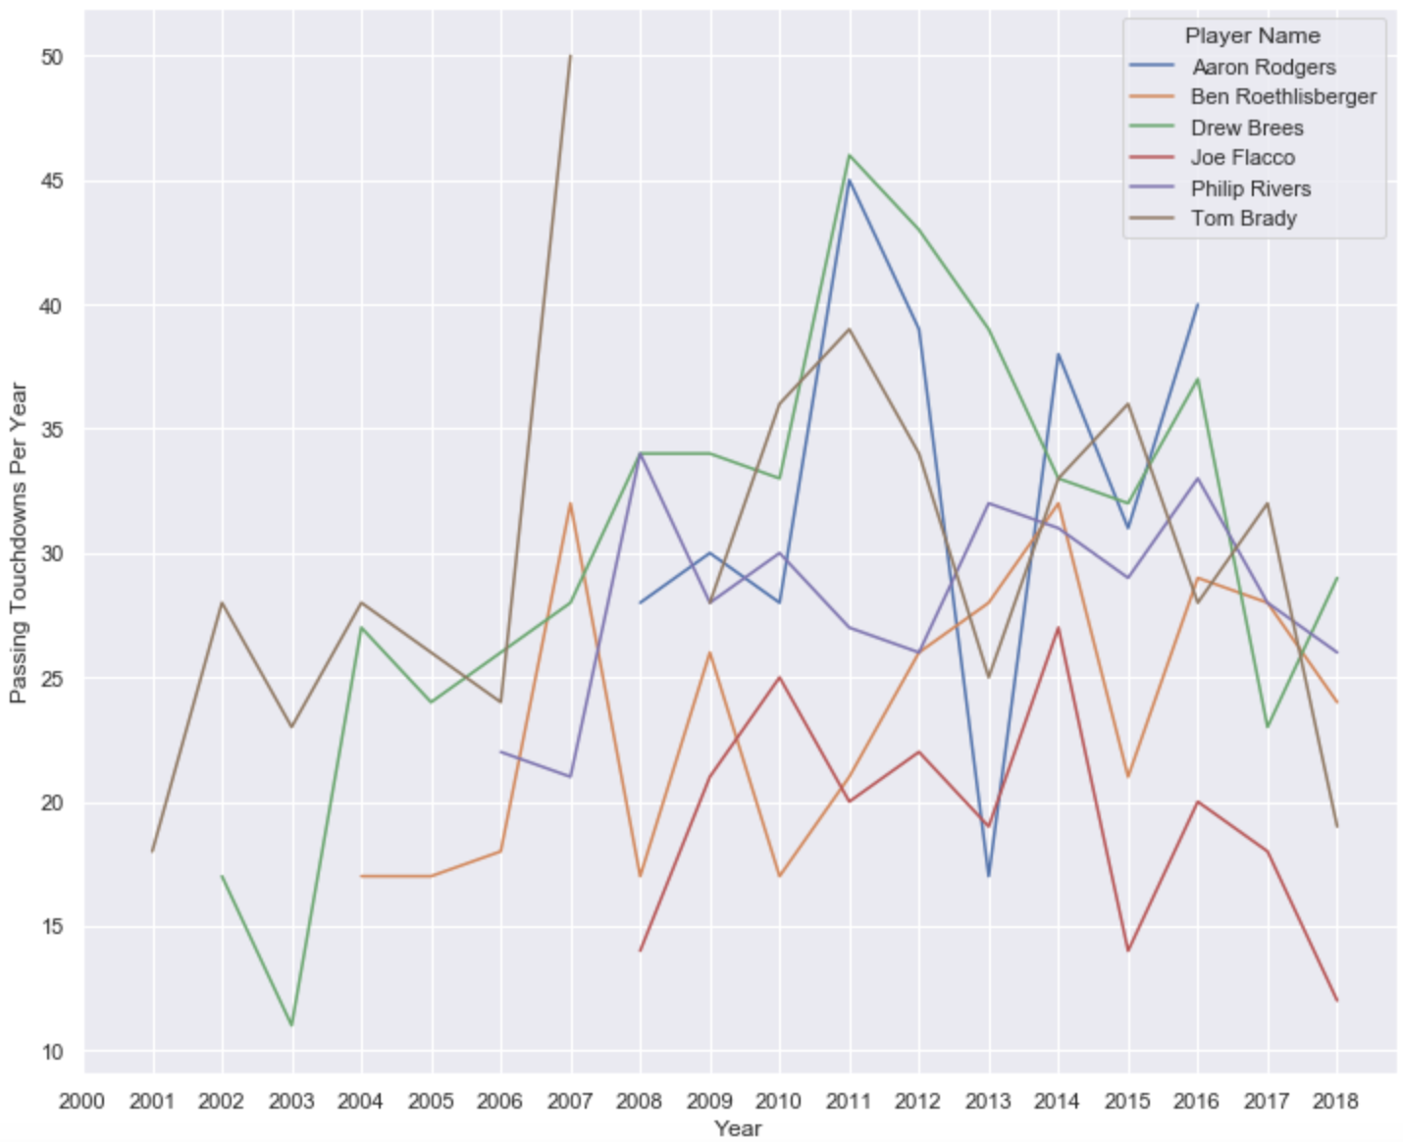
Descriptive Analytics were used to provide insight on data

Slide 6
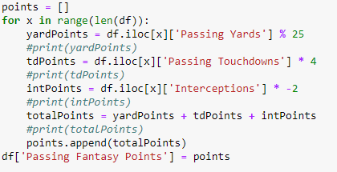
Predicting Fantasy Football points using features independent of its calculation.
Features Independent of Fantasy Point Calculation
Passing Completions
Passing Attempts
Passing First Downs
Longest Passing Play
Sacks
Quarterback Rating

Slide 7
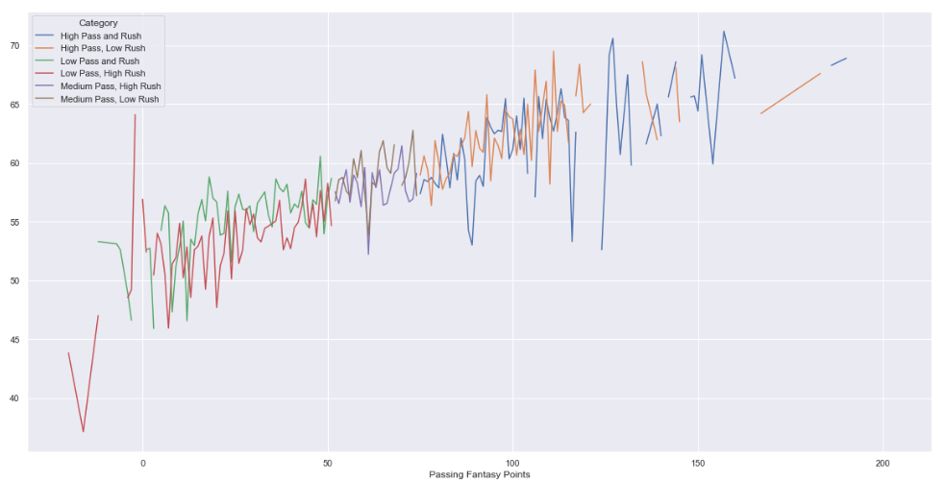
Multilinear Regression Models will be used to predict Fantasy Points
Passing Completion

